Slide 1


Sergeant George Smith
California Highway Patrol

Slide 2


California Highway Patrol
Counterterrorism and Threat Awareness Section
Emergency Notification and Tactical Alert Center
Formed in 2002
Statewide Coordinator for Missing Person Alerts
Staffed 24 hours/day by uniformed CHP personnel
Located at CHP HQ in Sacramento, CA

Slide 3

State of California Missing Alert Plan

Slide 4
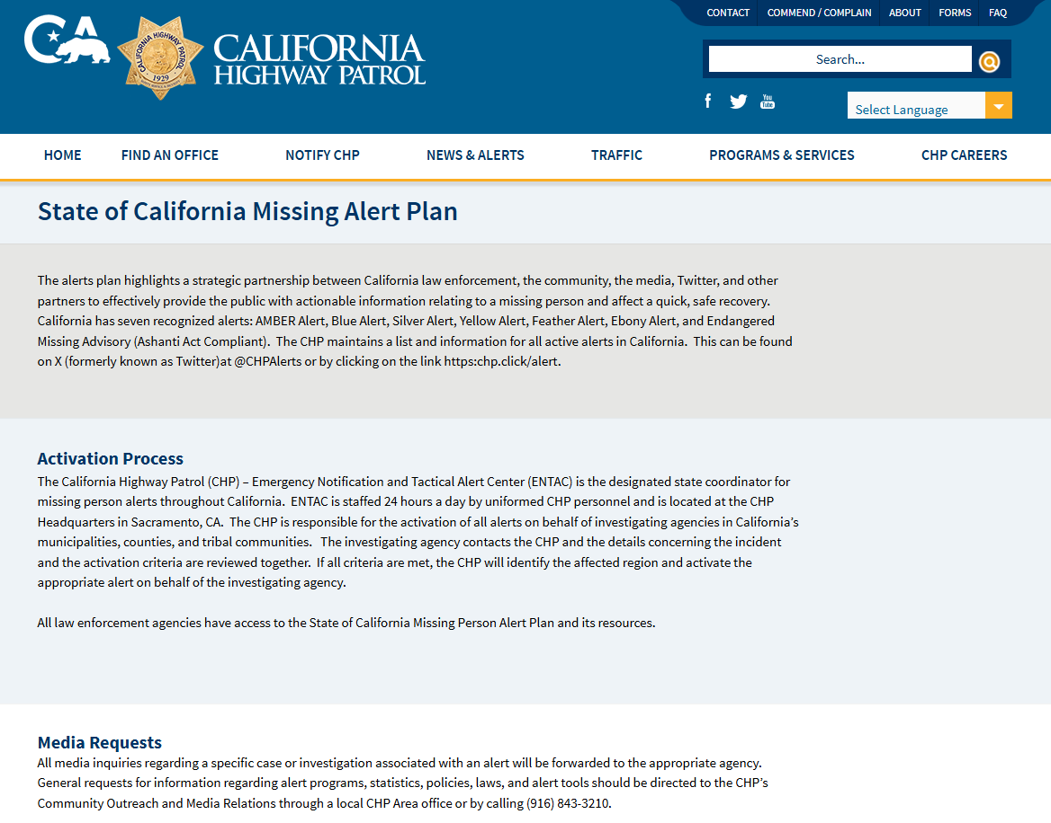

Slide 5
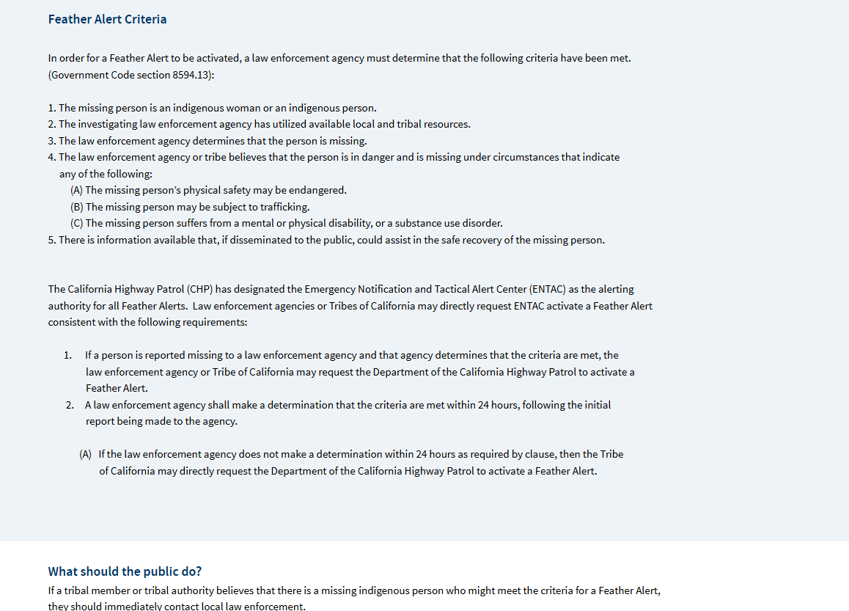

Slide 6
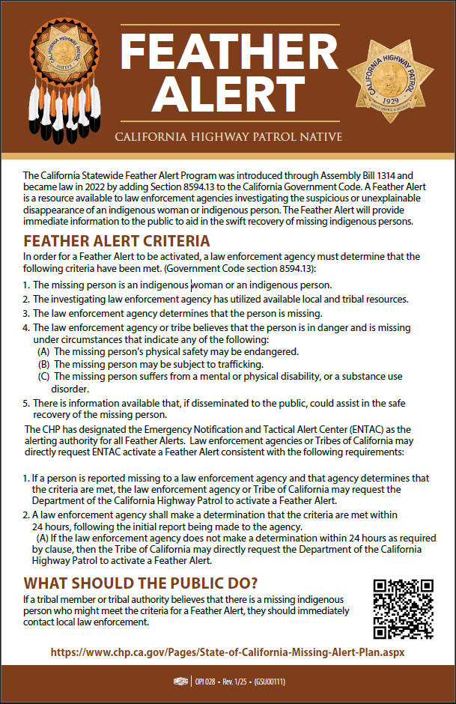

Slide 7
Feather Alert Criteria
The missing person is an indigenous woman or an indigenous person.
The investigating law enforcement agency has utilized available local and tribal resources.
The law enforcement agency determines that the person is missing.
The law enforcement agency or tribe believes that the person is in danger and is missing under circumstances that indicate any of the following:
    The missing person’s physical safety may be endangered.
    The missing person may be subject to trafficking.
    The missing person suffers from a mental or physical disability, or a substance use disorder.
There is information available that, if disseminated to the public, could assist in the safe recovery of the missing person

Slide 9
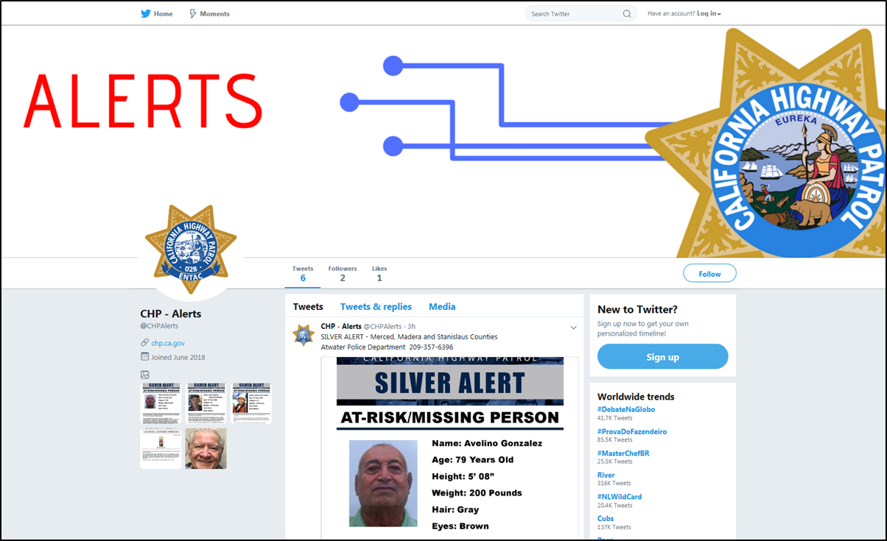

Social Media
X: @CHPAlerts
Over 245,000 Followers
Facebook: CHP – Alerts
9.5K Followers
Instagram: CHP – Alerts
1.6K Followers

Slide 10

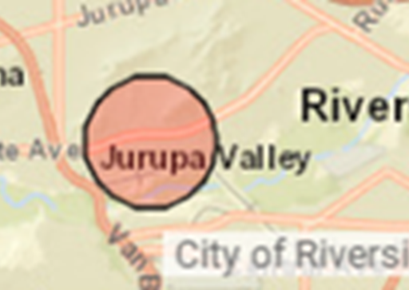
CHP Investigative Resources
Statewide Coordination
Statewide Air Support
Case Support Unit
Statewide LPR (FLOCK)
Everbridge Notification System
Wireless Emergency Alert (WEA)
Emergency Alert System (EAS)
BOLOS
Alert Flyers on X, Facebook and Instagram
Additional Investigative Support
Cell Phone Tracking

Slide 11
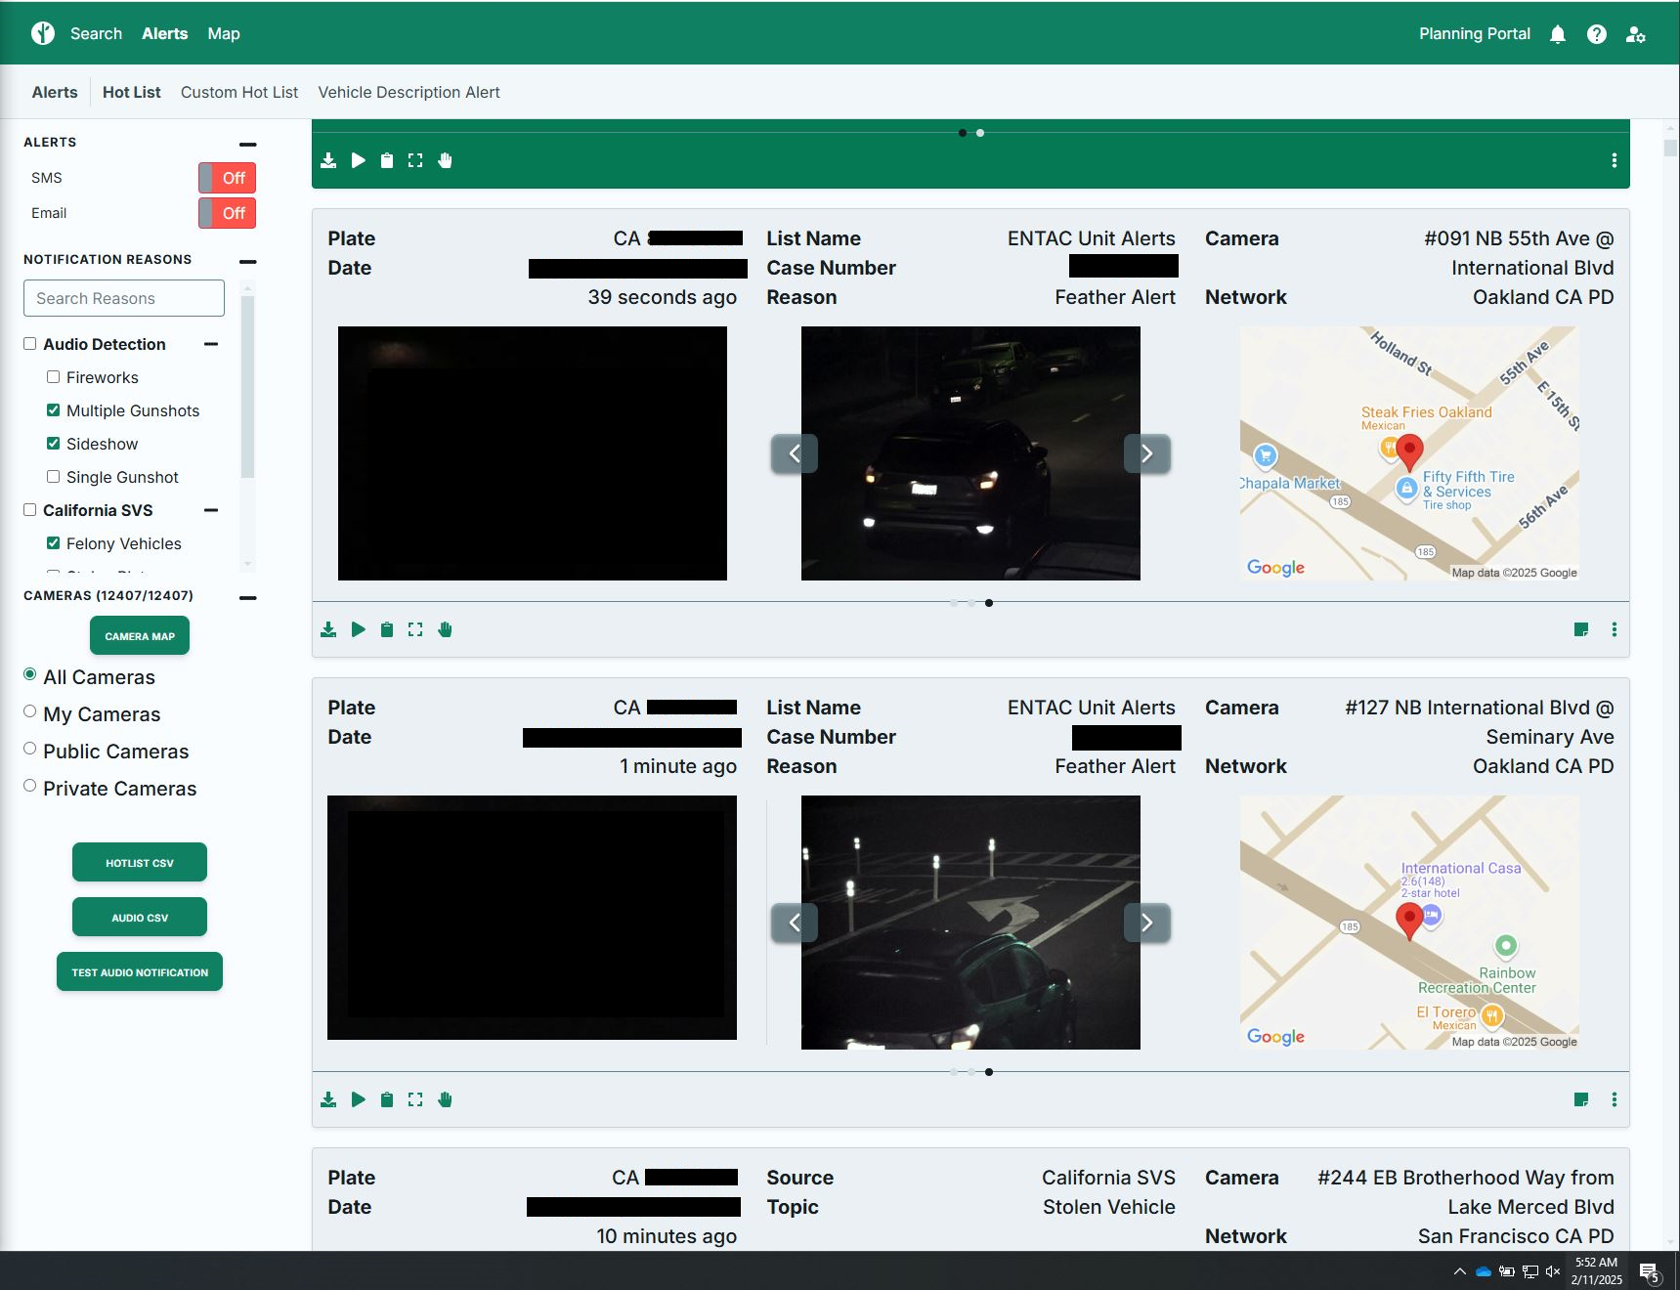

Slide 12


Slide 13
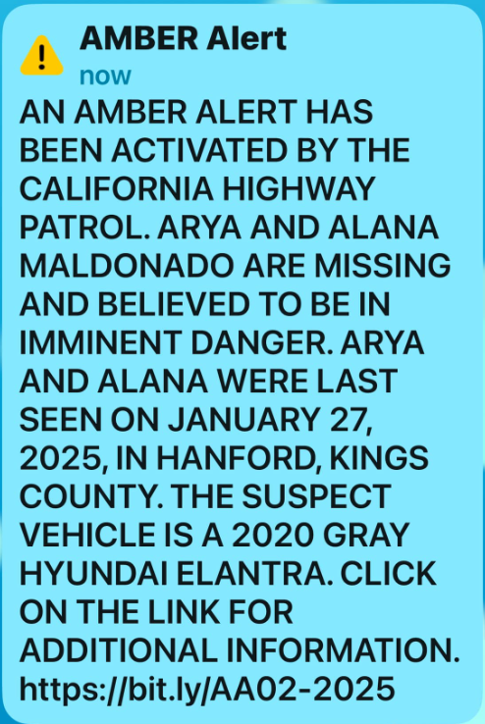

Slide 14
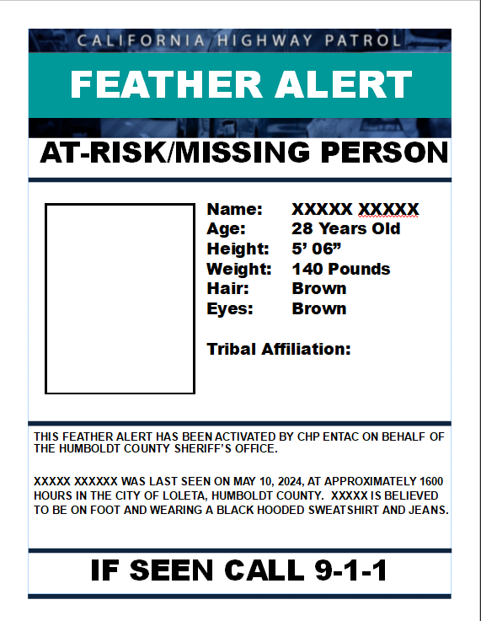
X
FACEBOOK
INSTAGRAM
SOCIAL MEDIA

Slide 15



What can happen when millions of eyes get the information?

Slide 16






Additional Alerts

Slide 17
Contact information and additional resources:
CHP ENTAC –
ENTAC@CHP.CA.GOV

